Slide 1
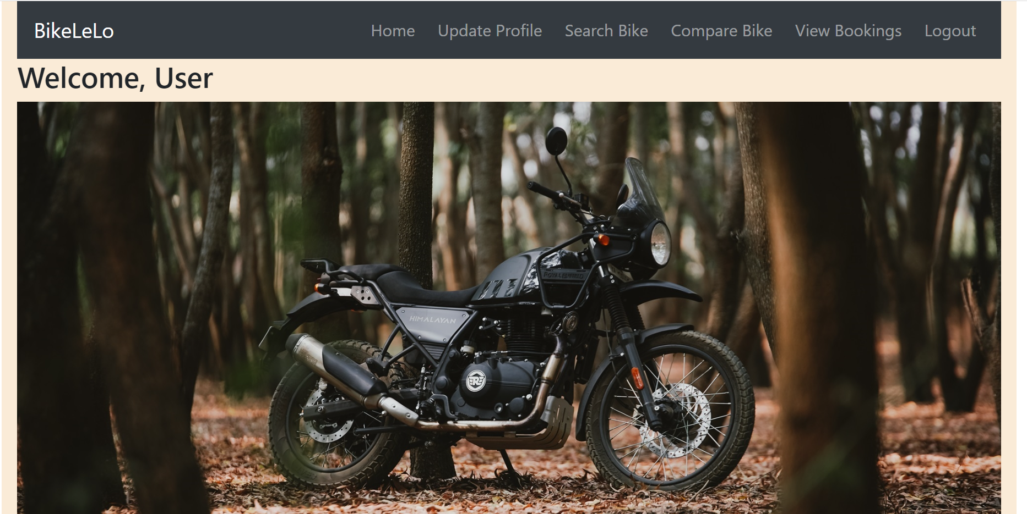
Online Bike Booking System

Slide 2
Index
Project Introduction
Project architecture
Technology Platform Used for Project
User Roles and Responsibility
Walk through System
Future extension
Conclusion

Slide 3
Project Introduction
1. Purpose of Project
The main objective of this project is to provide a platform for the users to get details about on road prices for different cities and can book their desired bike instantly.
2. Need
There are very less such computerized system from where one can book bike in advance from specific location.
Frequent visits to showroom to select a bike.
For booking bike from other city the clients/user needs to travel all the time.
High Demand for electric bikes there is a long waiting period.

Slide 4
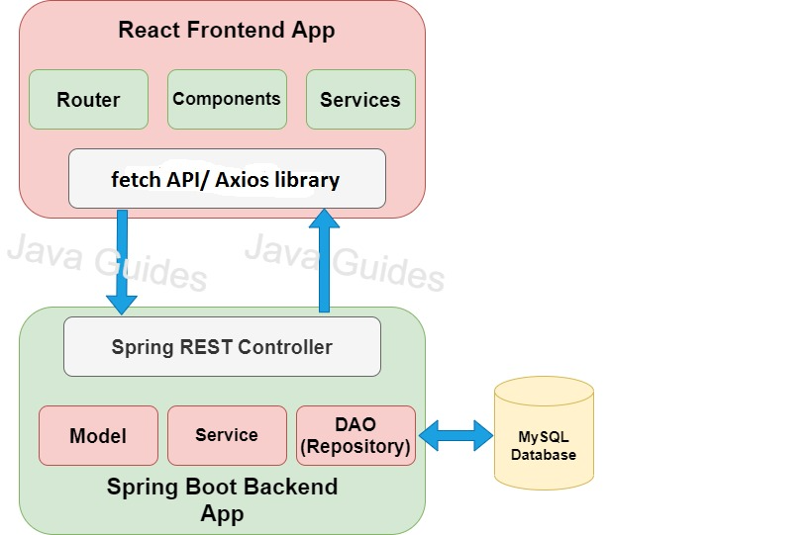
Project Architecture

Slide 5
Technology Used For Project :
Technology Used For Project :
Front-End : React JS, Bootstrap
Back-End : Java, Spring Boot REST API, JPA
Middleware :
2. Reason for selecting these technology :
Why React ?
The component-based approach, well-defined lifecycle, and use of just plain JavaScript make React very simple to learn, build a professional web and support it.
React uses a special syntax called JSX which allows you to mix HTML with JavaScript.
Why Spring Boot ?
A few benefits of using Spring Boot for your REST APIs include: No requirement for complex XML configurations. Embedded Tomcat server to run Spring Boot applications. An auto-configuration feature by Spring Boot that configures your application automatically for certain dependencies.

Slide 6
User Roles and Responsibility
User Roles : User, Showroom, Admin.
Responsibility for each user :
User : Book the Bike from Showroom
Showroom : Update Status of Booking
Admin : Showroom Creation, Add Bike, Generate Report
Use Case :
User : Register, Search, Compare and Book Bike.
Showroom : Update Booking Status.
Admin : Create and delete Showroom account,
Delete User account, Add/Delete/Update Bike,
Generate Sales Report.

Slide 7
Future extensions
Add encryption for data security.
User will be able to request for test drive service in their cities.
User will be able to pay in installments.
Document verification part will be done online.

Slide 8
Conclusion
Online Bike Booking System provides better Bike booking platform to User and Showroom can get the business for their vehicle efficiently.
Our System provides a very user-friendly platform where User can easily search & compare the Bike, Book the Bike and view the bookings.
Showroom can view all the bookings also can update booking status.
Our system is aimed efficient management of various tasks like booking the bike for User on daily basis, managing payment for booking, adding the bike. Monitor sales along with managing all the account and information on a single platform.

